Slide 1
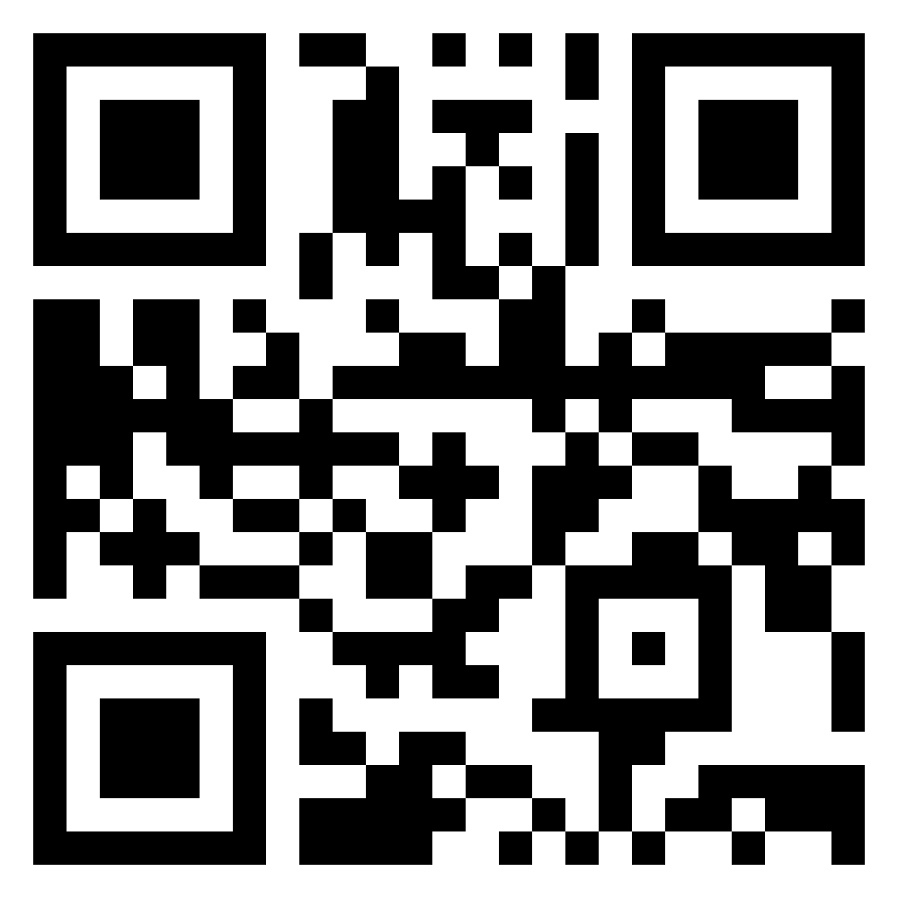
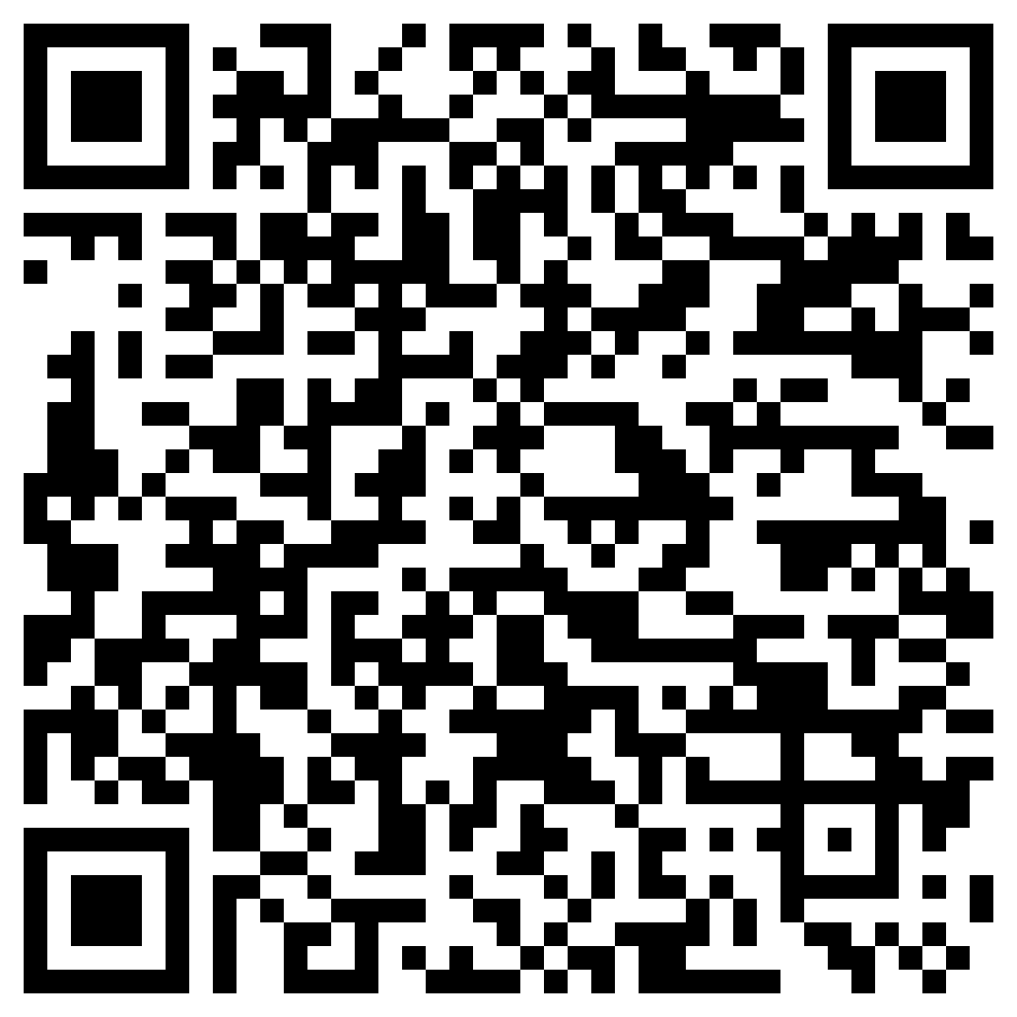


GAL: Gradient Assisted Learning for Decentralized Multi-Organization Collaborations
Presenter: Enmao Diao
Paper
Code
Enmao Diao¹ Jie Ding² Vahid Tarokh¹
¹Duke University ²University of Minnesota
Notes:
Hello everyone my name is Enmao Diao today I will present GAL: Gradient Assisted Learning for Decentralized Multi-Organization Collaborations.
This work is published by Enmao Diao, Jie Ding, and Vahid Tarokh .
You can access our paper and source codes by scanning these QR codes.

Slide 2
Overview
Motivation
Gradient Assisted Learning
Vertically-distributed data
Objectives
The GAL algorithm
Experiments
Model Autonomy
Comparison with Assisted Learning (AL)
Case Studies
Conclusion
Notes:
First, I will talk about our motivation.
Then I will introduce our proposed method Gradient Assisted Learining.
Next, I will demonstrate our experimental results with respect of different aspects of our proposed method.
Finally, I will draw our conclusion and discuss future works.

Slide 3
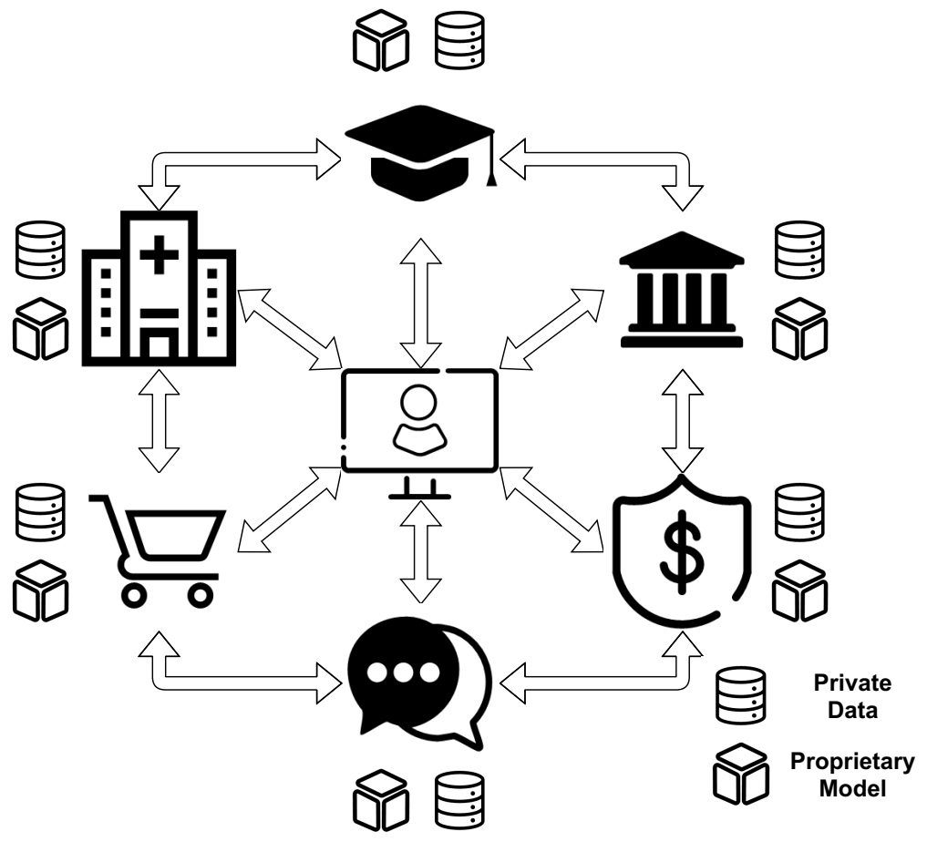
Motivation
Fusion of knowledge from numerous decentralized organizations
Unable to centralize their data and fully collaborate to learn a shared model
Figure 1. Decentralized organizations form a community of shared interest to provide better Machine-Learning-as-a-Service.
Notes:
One of the main challenges in harnessing the power of big data is the fusion of knowledge from numerous decentralized organizations that may have proprietary data, models, and objective functions. Due to various ethical and regulatory constraints, it may not be feasible for decentralized organizations to centralize their data and fully collaborate to learn a shared model.
With the help of our framework, they can form a community of shared interest to provide better Machine-Learning-as-a-Service (MLaaS) without transmitting their local data, models, and objective functions.
Discard:
As illustrated in Figure 1, a medical institute may be helped by multiple clinical laboratories and pharmaceutical entities to improve clinical treatment and facilitate scientific. Financial organizations may collaborate with universities and insurance companies to predict loan default rates. The organizations can match the correspondence with common identifiers, such as user identification associated with the registration of different online platforms, timestamps associated with different clinics and health providers, and geo-locations associated with map-related traffic and agricultural data.

Slide 4
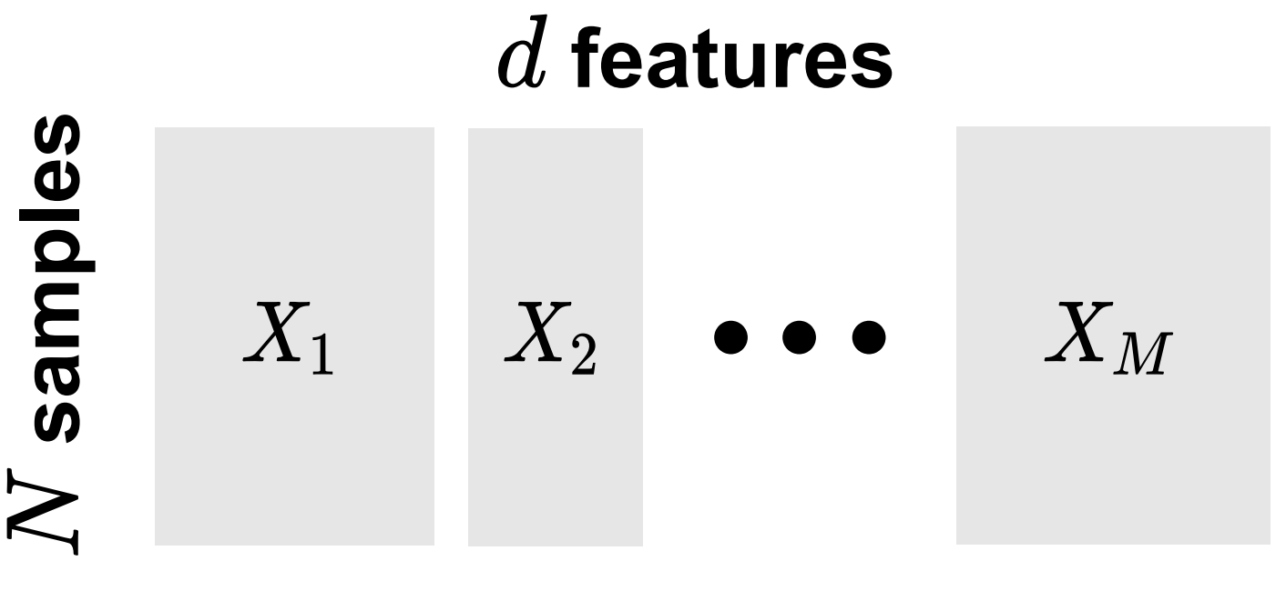

Gradient Assisted Learning (GAL)
Vertically-distributed data
Suppose there are $M$ organizations. Each organization $m$ only holds $X_{m}$, a sub-vector of the joint data $X$
Sponsor (Alice) : $X_{1}$, $y_{1}$
Assistors: $X_{2}, …,X_{M}$
Figure 2. An illustration of organizations’ vertically distributed data.
Notes:
We propose a decentralized learning framework named Gradient Assisted Learning
Suppose that there are $N$ data observations where $y $ and $x$ respectively represent the task label and feature variables, and $d$ is the number of features.
Suppose there are $M$ organizations. Each organization $m$ only holds $X_{m}$, a sub-vector of the joint data $X$
Alice, the organization to be assisted, has local data $x_1$ and task label $y_1$, while other organizations are collaborators with local data $x_2 \ldots x_M$

Slide 5
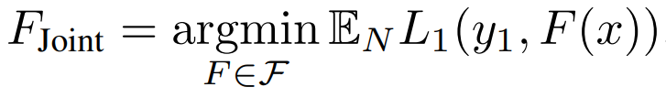
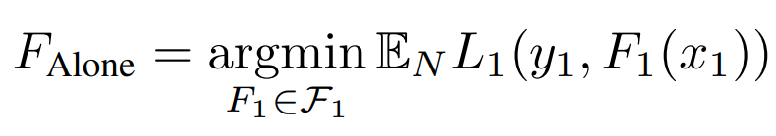
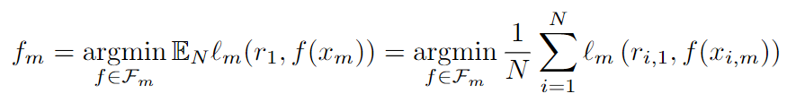
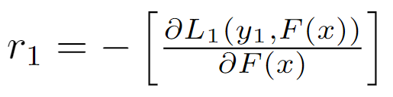
Gradient Assisted Learning (GAL)
Objectives
Ideal case
Without assistance
Gradient assistance
Our objective
Pseudo-residuals
Notes:
In an oracle case, Alice would be able to operate on other organizations' data as well. In general, the ideal case for Alice is to minimize the joint empirical risk,
In reality, Alice has no access to the complete data and model resources of other organizations. Without assistance from other organizations, Alice would learn a model that minimizes the local empirical risk
Our method will require Alice to occasionally send continuous-valued vectors r sub 1which we call the pseudo-residuals. The pseudo-residuals approximate the fastest direction of reducing the training loss in hindsight
Each organization $m$ will perform the empirical risk minimization with local loss functions l sub m

Slide 6
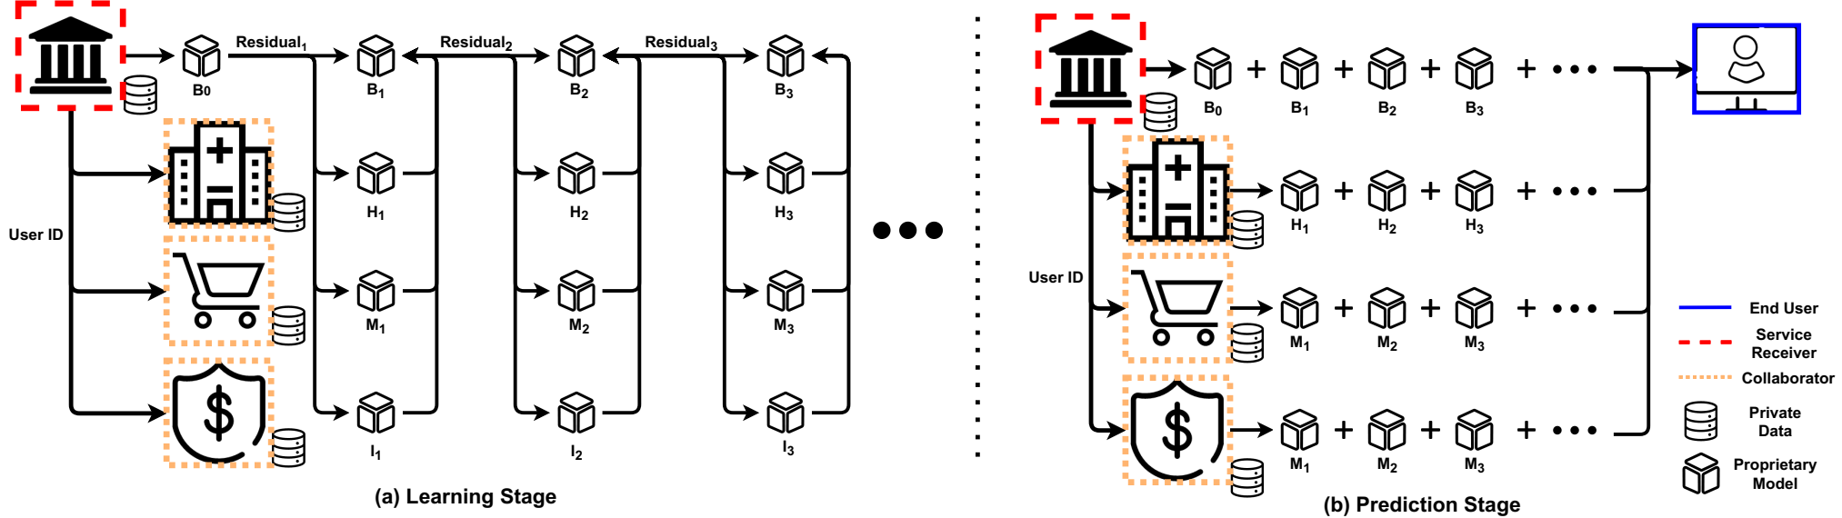
Gradient Assisted Learning (GAL)
The GAL algorithm
Asymptotic convergence analysis
Reduce to the standard gradient boosting algorithm when there is only one organization
Figure 3. Learning and Prediction Stages for Gradient Assisted Learning (GAL).
Notes:
In the learning stage, each organization $m$ will only need to perform the empirical risk minimization using the pseudo-residuals sent by Alice at each iteration.
In the Prediction stage, other organizations send prediction results generated from their local models to Alice, who will calculate a prediction result that is implicitly operated on all the data.
Interestingly, the proposed algorithm reduces to the standard gradient boosting algorithm when there is only one organization.
We provide Asymptotic convergence analysis of Gradient Assisted Learning in our paper.

Slide 7
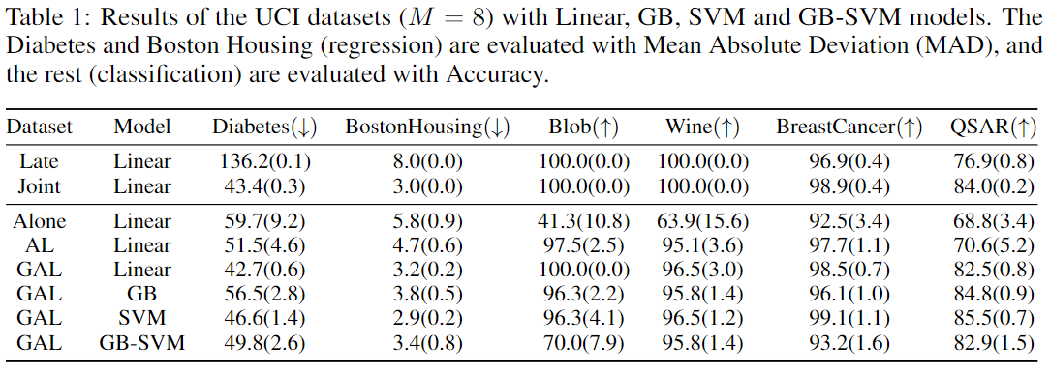
Experiments
Model Autonomy
An organization with little informative data and free choice of its local model (model autonomy) can leverage others' local data and models and even achieve near-oracle performance.
Notes:
We demonstrate the experimental results of our proposed algorithm from various aspects. GAL allows each organization to choose its own local model. The results also demonstrate that with GAL, an organization with little informative data and free choice of its local model can leverage others' local data and models and even achieve near-oracle performance.

Slide 8
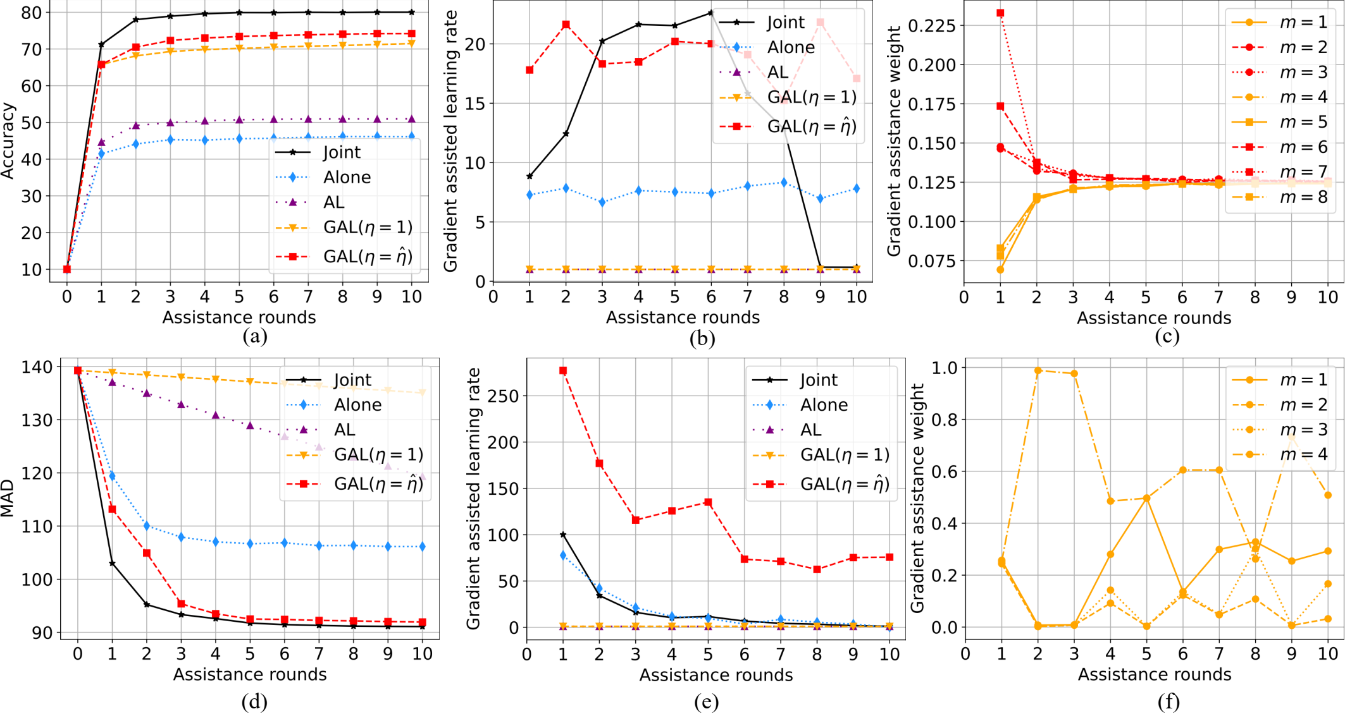
Experiments
Comparison with Assisted Learning (AL)
Figure 4. Results of the CIFAR10 (a-c) ($M=8$) and MIMICL (d-f) ($M=4$) datasets. GAL significantly outperforms ‘Alone’ and ‘AL’ and performs close to the centralized baselines.
Notes:
We demonstrate the learning curves to compare with Assisted Learning.
As demonstrated in our experiments, the proposed GAL outperforms AL in terms of predictive performance.
The gradient assistance weights exhibits interpretability of the importance of organizations because the weights of the central image patches ($m=\{2,3,6,7\}$) of CIFAR10 dataset are larger than the boundary patches ($m=\{1,4,5,8\}$) in the first few iterations.

Slide 9
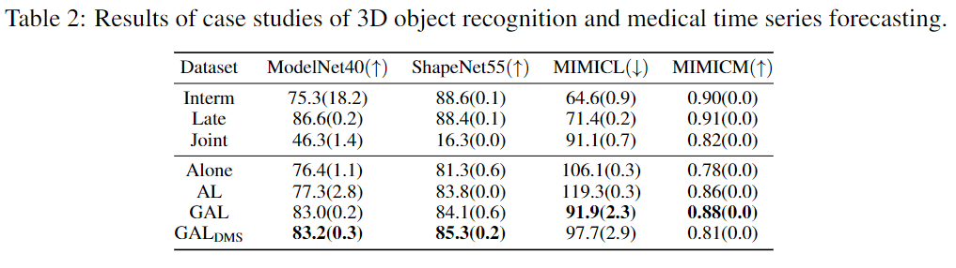
Experiments
Case Studies
Deep Model Sharing
Three-dimensional object recognition
Medical time series forecasting
Notes:
We propose Deep Model Sharing (DMS) to allow sharing feature extractors of deep models across all iterations to save memory. We also perform case studies on Three-dimensional object recognition and Medical time series forecasting. The results demonstrate the wide applicability of our proposed algorithm.

Slide 10
Conclusion
We propose a Gradient Assisted Learning (GAL) algorithm that is suitable for large-scale autonomous decentralized learning.
We provide asymptotic convergence analysis and practical case studies of GAL. For the case of vertically distributed data, GAL generalizes the classical Gradient Boosting algorithm.
Our proposed method can significantly outperform learning baselines and achieve near-oracle performance on various benchmark datasets.
Future works can study GAL with Adversarial Learning, Fairness, and Automated machine learning
Notes:
• We propose a Gradient Assisted Learning (GAL) algorithm that is suitable for large-scale autonomous decentralized learning. Our method enables simultaneous collaboration among organizations without sharing data, models, and objective functions.
• We provide asymptotic convergence analysis and practical case studies of GAL.
• Our proposed method can significantly outperform learning baselines and achieve near- oracle performance on various benchmark datasets.
• Future works can study GAL with Adversarial Learning, Fairness, and Automated machine learning

Slide 11
Thank you!

